Slide 1
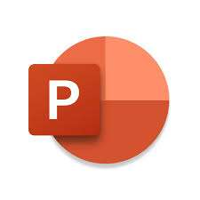
INFORMATION AND COMMUNICATION TECHNOLOGIES
NOMS DES PARTICIPANTS :
Chennit Zineb
Bentebbal Sabrine
Daghboudj Hiba
Djabella Lounes
Bentafat Wail

Slide 2
Introduction
Information and Communication Technologies (ICT) represent a diverse array of technologies pivotal to modern communication, work, and information access.
ICT amalgamates tools, devices, and applications, enabling the creation, storage, and transmission of various forms of information. Its significance lies in revolutionizing global connectivity, spawning new industries, and optimizing business efficiency.
Tracing back from early computers to today’s digital landscape, ICT has involved, encompassing the internet ,social media, and cloud computing .
Subsequent sections will delve into specific areas like Google services, Microsoft tools, Git, and GitHub.

Slide 3
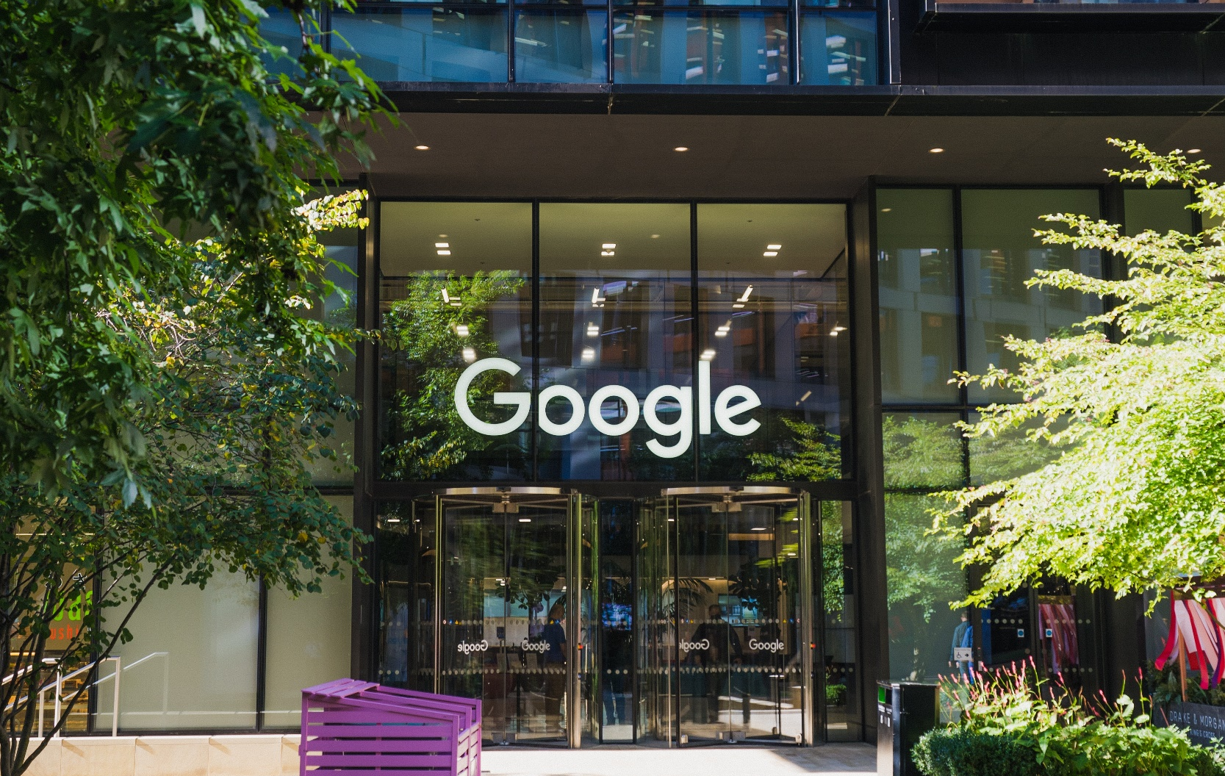

Microsoft tools:
The most frequently used Microsoft Office applications include:
Microsoft Word: Used for creating and editing text documents.
Microsoft Excel: Employed for organizing and analyzing data in tables.
Microsoft PowerPoint: Utilized for designing and presenting slideshows.
Microsoft Outlook: A tool for managing email and calendars
.
Microsoft Teams: Designed for online collaboration, meetings, chats, and file sharing.
Notes:
https://pixabay.com/photos/architecture-building-amsterdam-1448221/

Slide 4

Differences between Microsoft 365 and Office 2019
Microsoft 365:
subscription-based with cloud-based features and regular updates.
Benefits: access from any device, real time collaboration, latest software versions, and additional perks like OneDrive storage and Skype minutes.
Drawbacks: recurring fees required, dependency on internet connectivity, potential unnecessary features.
Office 2019:
One-time purchase without online services or upgrades.
Benefits: One-time ownership, offline usage, selective application choices.
Drawbacks: no updates beyond security fixes, lacks cloud services, limited to one device with no license transferability.

Slide 5
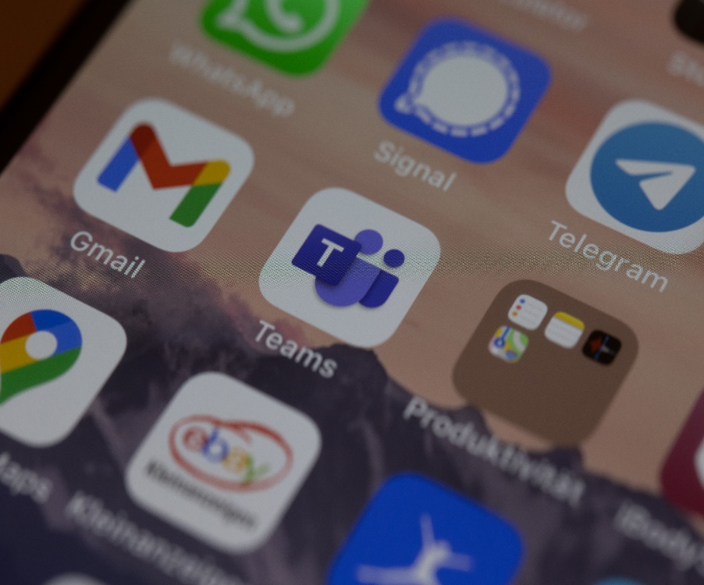
Google Services
Google Services provide online tools for enhanced digital experiences across communication, productivity, and entertainment, utilizing cloud computing for device accessibility.
Key Google Services and Functions:
Google Search: Primary tool for internet information retrieval.
Gmail: Secure and efficient email communication platform.
Google Maps: Navigation and local business information service.
Google Drive: Cloud storage and file-sharing solution.
Google Calendar: Time-management and scheduling application.
Google Docs, Sheets, Slides: Collaborative web-based tools for document creation and editing.
Google Photos: Platform for photo and video storage, organization, and sharing.
Google Chrome: Web browser known for speed, simplicity, and security.
YouTube: Video-sharing platform for uploading, sharing, and viewing content.
Google Translate: Language translation service supporting text, speech, and image translations.

Slide 6

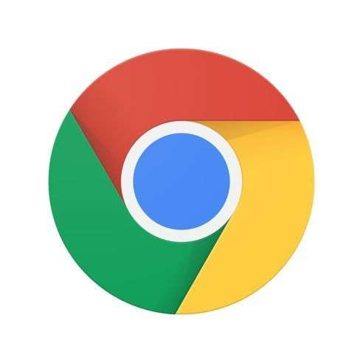
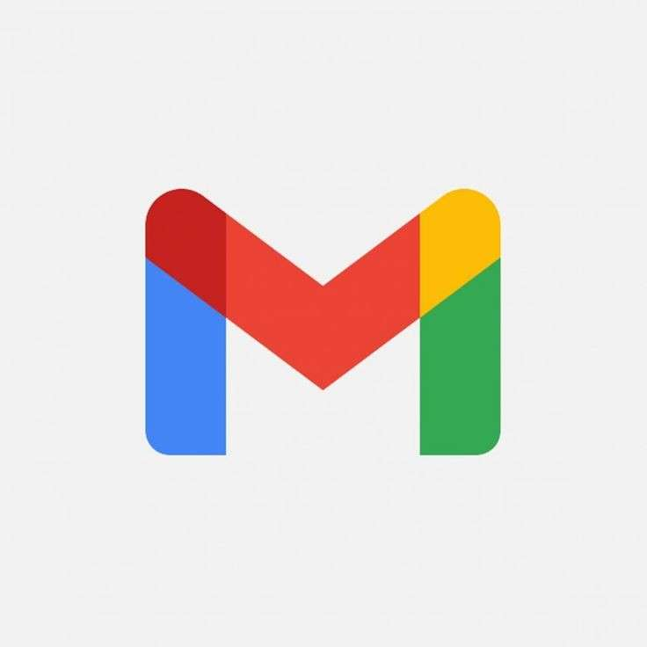
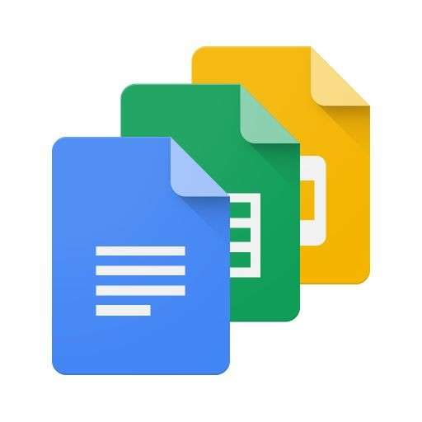
Key differences among Google Service
Integration
functionality
Integration allows seamless collaboration, like merging Google Drive files into Google Docs.
Google Services are specialized, catering to diverse needs with distinct functionalities.
Accessibility
Google Services ensure universal accessibility across desktops, smartphones, and tablets..
Notes:
Source of Image:-
https://www.freepik.com/free-photo/portrait-of-young-businessman-talking-on-mobile-phone-near-the-window_3156903.htm#term=corporate%20people&page=2&position=12
https://www.freepik.com/free-photo/smiling-business-woman-pointing-finger-on-copy-space-isolated-portrait_1119372.htm#term=corporate%20people&page=5&position=19
https://www.freepik.com/free-photo/smiling-mature-businessman-talking-on-mobile-phone_3105768.htm#term=corporate%20people&page=6&position=27
https://www.freepik.com/free-photo/smiling-brunette-manager-with-crossed-arms_899841.htm#term=corporate%20people&page=8&position=36

Slide 7

Git and GitHub
1/Git:
Git is a distributed version control system created by Linus Torvalds in 2005, facilitating collaborative software development by tracking changes, enabling multiple developers to work concurrently, and offering features like branching and merging for efficient project management.
2/GitHub:
GitHub, launched in April 2008 by Tom Preston-Werner, Chris Wanstrath, and PJ Hyett, is a web-based platform enhancing Git with tools for collaborative software development. It provides a graphical interface for Git repositories, supports code review, issue tracking, and project management, serving as a central hub for developers, especially for open-source projects.
Notes:
https://pixabay.com/photos/room-flower-white-cabinet-plant-4161931/

Slide 8
Microsoft and Git
Microsoft acquired GitHub for $7.5 billion in stock, allowing GitHub to maintain its independence while integrating with some Microsoft tools.
Historically competitors, Microsoft and Google have collaborated in areas like cloud services interoperability. GitHub serves developers across ecosystems, including Google's platforms, for source code management and collaboration.
Note: Relationships and developments among these companies may have changed; refer to updated sources for current information.
June 2018

Slide 9
Conclusion
Information and Communication Technologies (TIC) profoundly influence modern society, exemplified by Google's integrated tools like Gmail and Google Drive. Microsoft Tools offer adaptability and unity in a dynamic tech landscape, while Git and GitHub highlight collaboration in software development. TIC's evolution enhances sectors like healthcare and business, with future trends like AI and decentralized technologies shaping a connected digital era.

